Slide 1


Sparky The Fire Dog
Incident Response As Code
@tapaswenipathak tapaswenipathak@gmail.com
Monitorama 2018 - Portland, OR

Slide 2


Slide 3
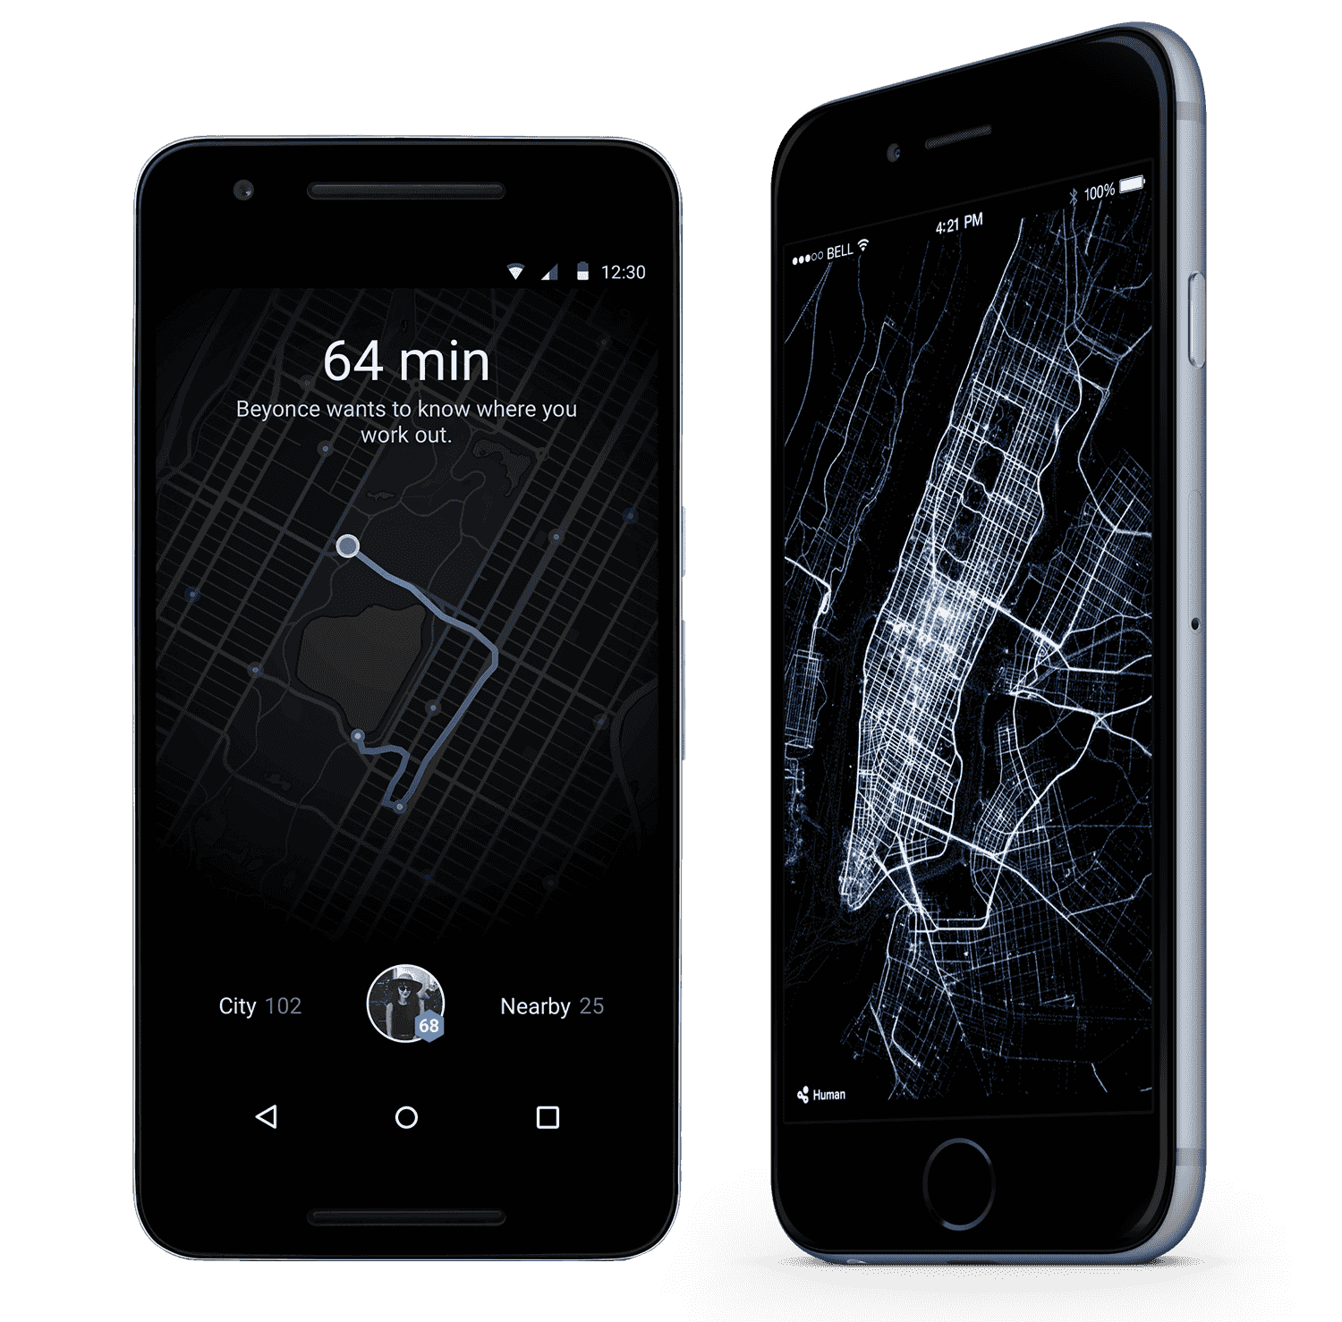

Slide 5


Slide 6
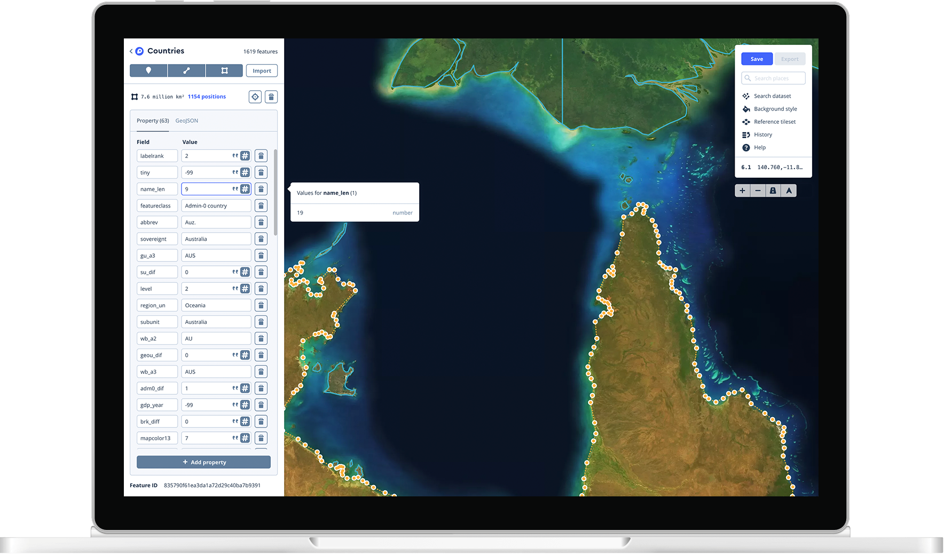

Slide 7
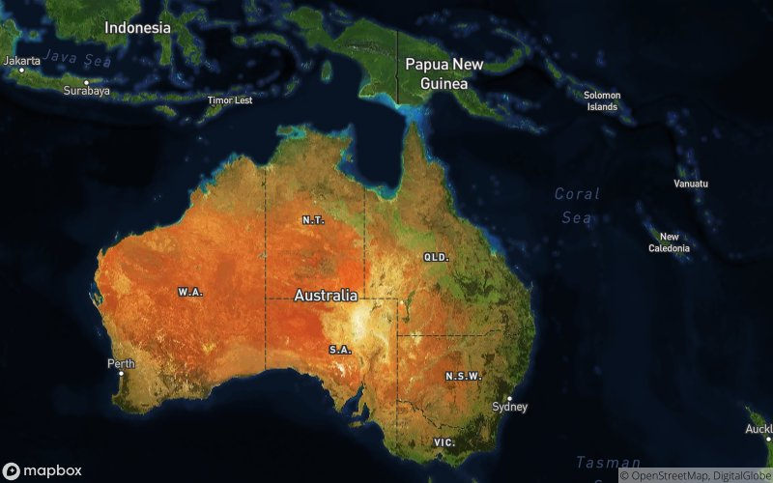

Slide 8
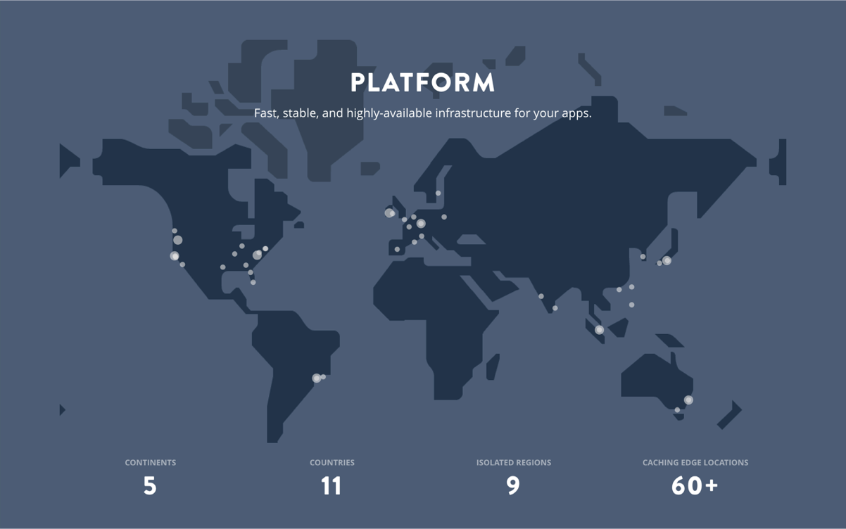
Platform @Mapbox

Slide 9


Slide 10



Slide 11
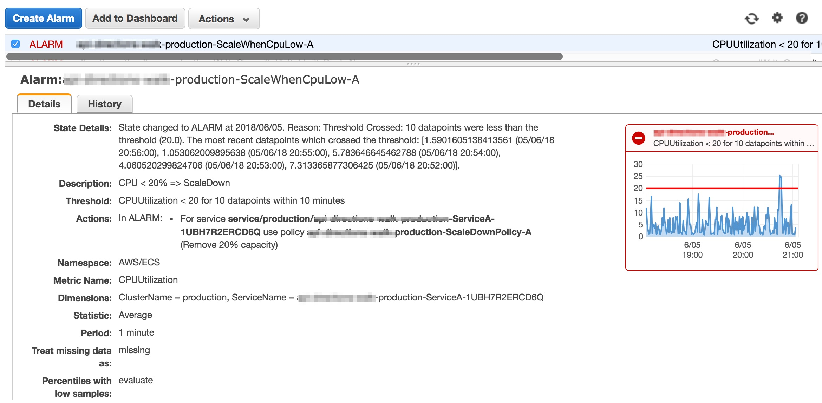

Slide 12
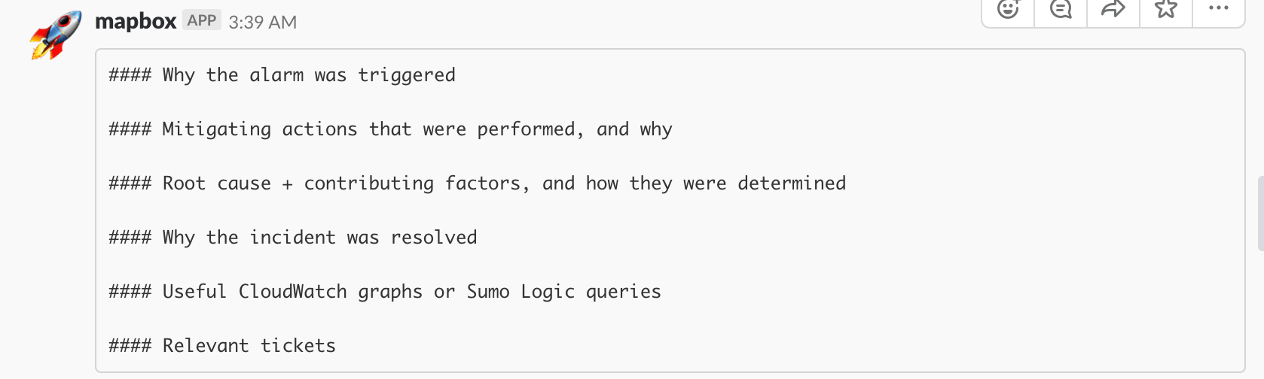

Slide 13

Say Hi to Sparky!

Slide 14
Avoid subscription confirmations upon creation of every new stack
Enrich the data associated with the alarm in real-time
Reformat the alarm information
Aggregate all of your team's alarms into a single PagerDuty policy
Links to targeted Sumologic searches
Get the root cause analysis
Sparky

Slide 15
provides a persistent SNS topic → provides a lambda function to receive CloudWatch alarms → forwards them to PagerDuty on a per-team basis.
Sparky's API is an SNS topic that any service can connect its CloudWatch alarms to.
Sparky is a published npm module so that this integration is easy.
Every alarm that is sent to a Sparky SNS topic is also sent straight to PagerDuty via email integration.
Sparky

Slide 16
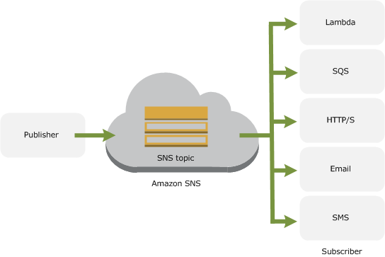

Slide 17
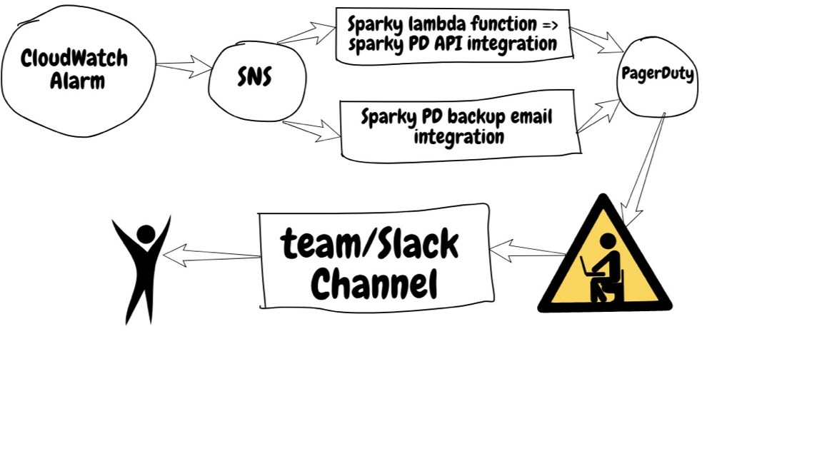

Slide 18
"1 - alarm a human right now"
"There were 234 5xx alarms on api-abc"
"100% of the 5xx's were 504's"
"The first 5xx was to /a/b/c.png at 4:27:33 AM UTC"
"There was a slow request on api-core at 4:27:09 AM UTC"
"I reran the request and it is still slow"
"The slow request was to foo/bar/baz.html
"There were no application errors at the time"
"It does not look like any other public APIs are affected"

Slide 19
Setting up your own Sparky service
Create two PD services: staging and production.
Add integrations.
Email: @name.pagerduty.com
Clone down the Sparky repo.
Create two Sparky stacks: <team>-production and <team>-staging.
BackupEmail: Email (in case api integration fails)
AlarmEmail: Email (for alarms about Sparky stack)
Important Confirm all subscriptions in PagerDuty.

Slide 20
Future of Sparky: Scoring an Alarm (score 0: page a human now, score 1: send to micro events queue)
How many errors +/- 5 minutes around trigger time
Are the errors ongoing
Were they in multiple regions
How many 500s vs 502s vs 503s vs 504s
Were there any slow requests (ie., did not 504, but took 50 seconds)
Try re-running that request, is it still slow?
What was the very first error
Are there any fatal application errors
Group and count the application errors by type

Slide 22
Thank you!

